Slide 1
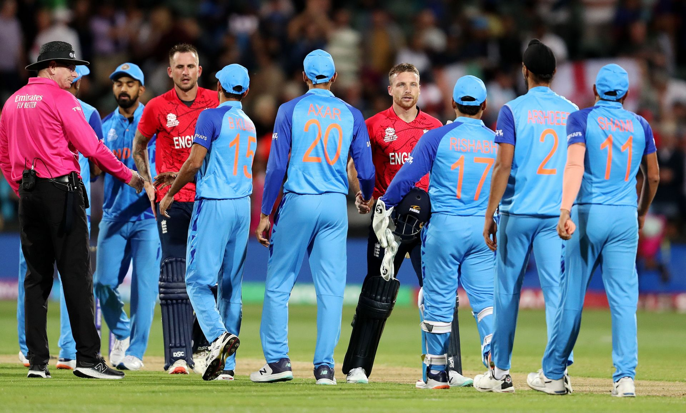
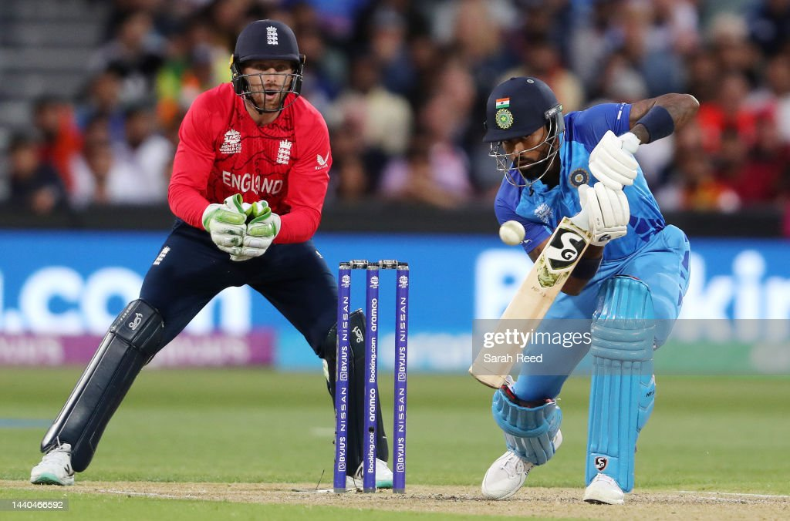
T20 CRICKET WORLD CUP
What went wrong for India?
2022
Business Intelligence
Professor Tristan Stull
Group 10B
Tra Mai Hoang, Anh Duc Ngoc Pham

Slide 2
TABLE OF CONTENT
Overview
I. Analysis
II. Analysis
Conclusion
Designed “fantasy” cricket team
MoneyBall relation
Technique Achievements
Business Problem
Datasource
Tools
Solution
Overview of England and India team performance
How does a cricket team win?
Are Indian players selected correctly?
Analysis + reasons why India lost to England
What should have done differently?
How to beat Pakistan?

Slide 3
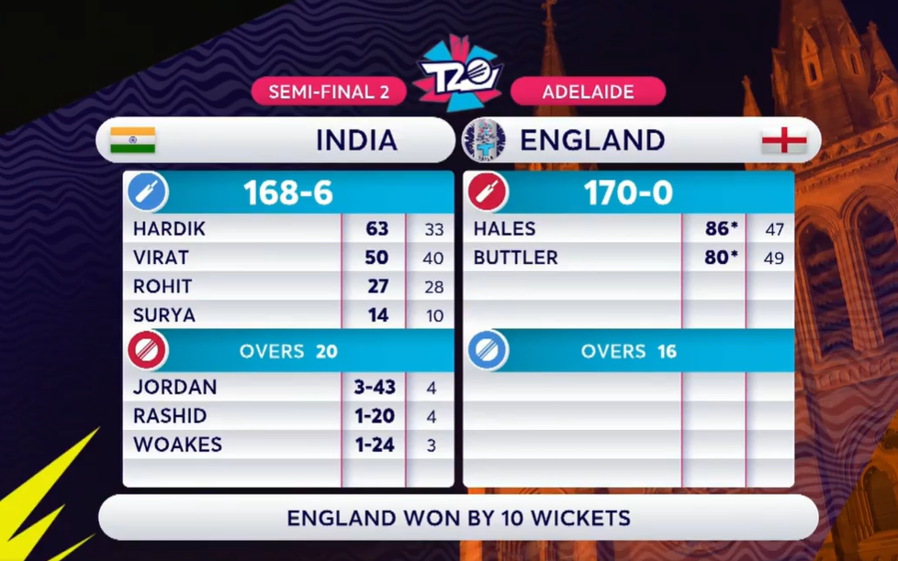

How to play cricket?
Scorecard of Semi-Final

Slide 4
MoneyBall relations
Focusing on training the batters and the fielder
5 quality bowlers while there is only 1 well-performing batter(Virat Kohli) can be considered an unbalanced line
Keep Virat Kohli and replace 2-3 bowlers by 2-3 better batters that have the average scoring in the same range of England's average batters. ( best option)
If India want to keep the same “bowler team”, they may summarize and calculate the average scoring of all “batters” and replace the best batter by three to four average batters that have the same or more average scoring as England.

Slide 5


